Slide 1
Fig: Autonomous car using ultrasonic sensors

Slide 2
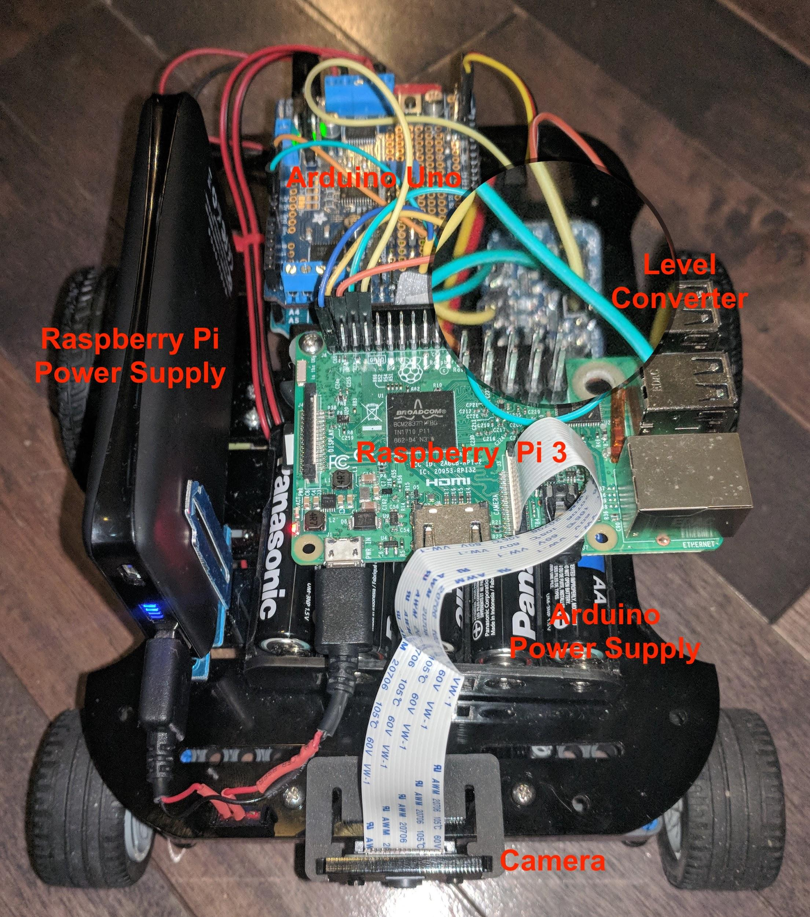
Fig: Autonomous car using camera

Slide 3
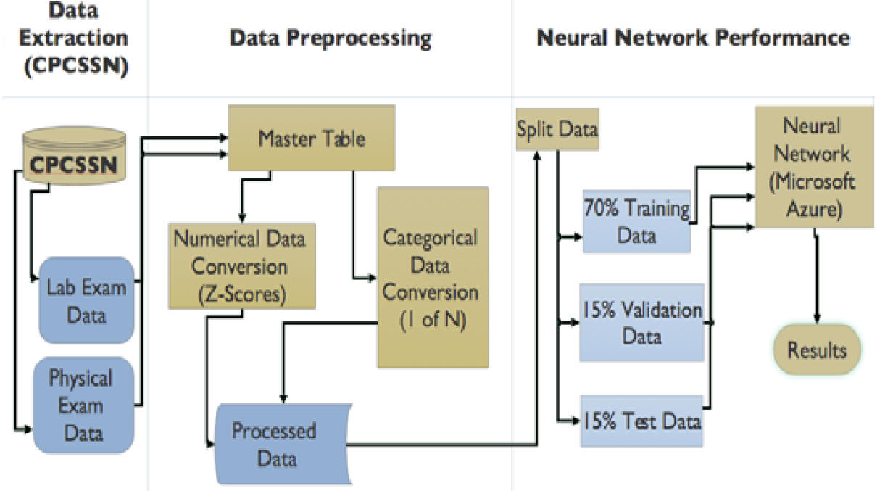
Fig: Analytic pipeline to detect Hypertension

Slide 4
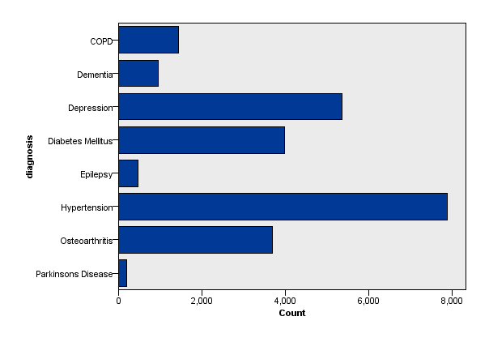
Fig: Hypertension is the most prevalent chronic disease

Slide 5
Fig: An example of cTAKES NLP

Slide 6
Fig: Performance comparison of KMPSO using the Wisconsin dataset

Slide 7
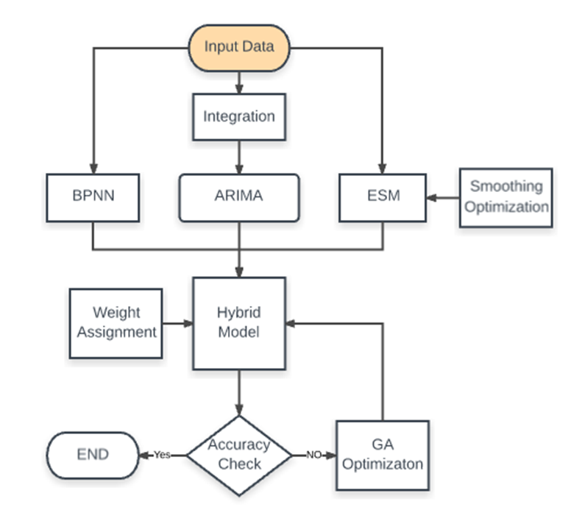
Fig: A hybrid PHM model applied for daily stock market prediction

Slide 8
Fig: The POD network and its predictive output.

Slide 9
Fig: Fall detection using wearable wireless sensors

Slide 11
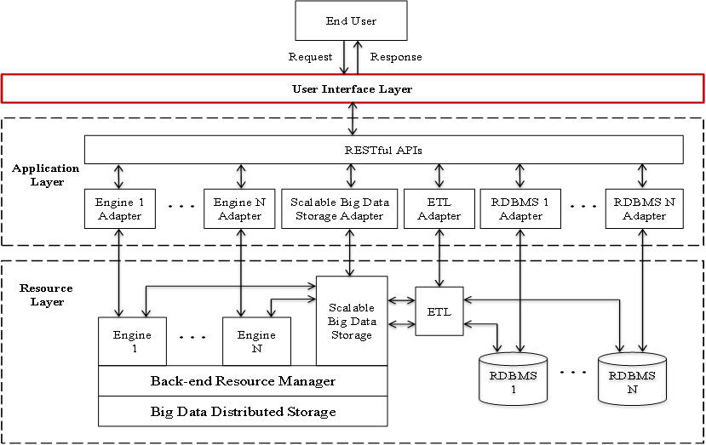
Fig: BINARY framework

Slide 12
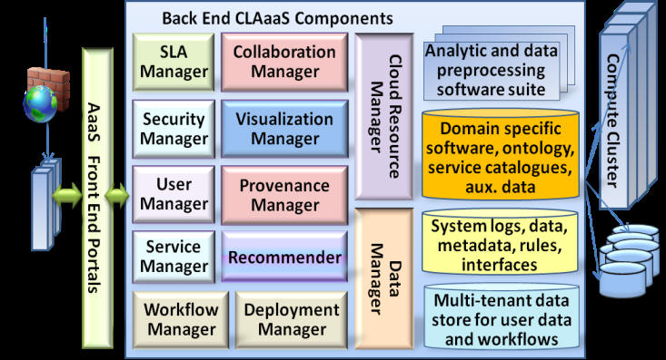
Fig: CLAaaS Architecture

